Slide 1
Toward prediction of agricultural traits using multi-Omics model
경상대학교
강양제

Slide 2
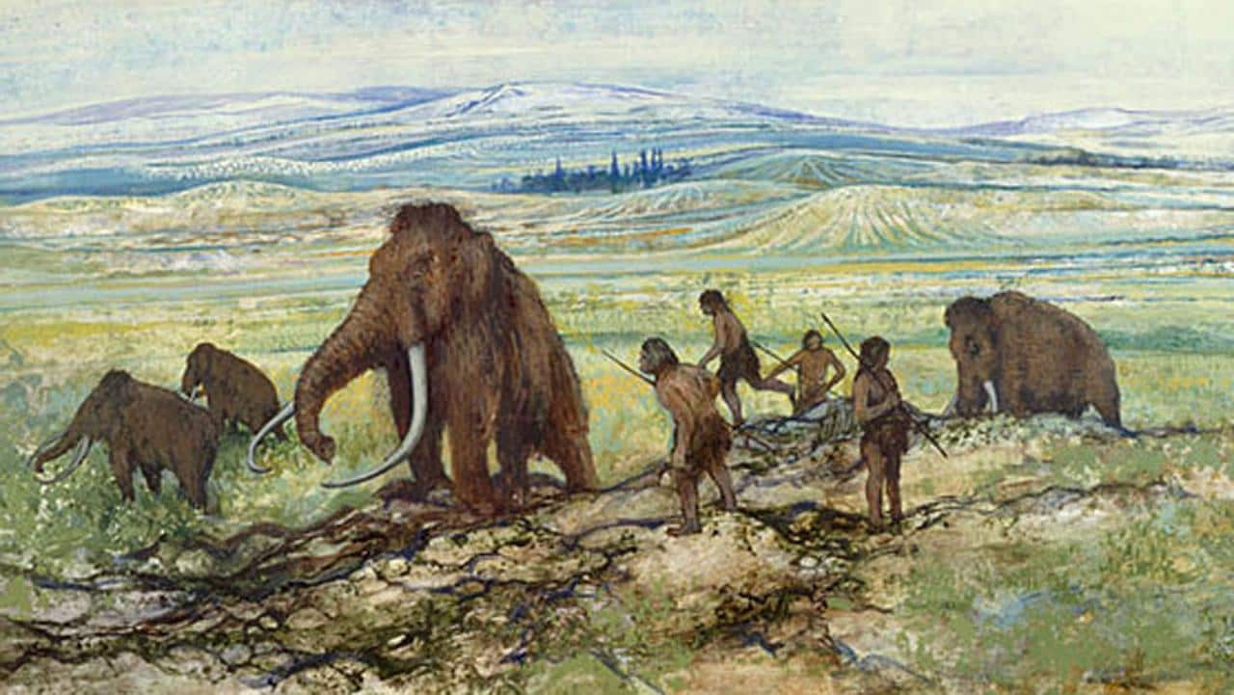
수렵
Data 3
Data 2
Agent 2
Agent 3
Data 1
Data 4
Agent 1
Agent 4
http://www.telegraph.co.uk/film/jurassic-world/pleistocene-park-dna-dinosaurs/

Slide 3
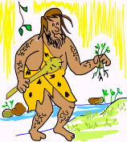
수집
Agent 4
Data 4
https://geneticliteracyproject.org/2014/10/30/whats-so-natural-about-natural-crop-breeding/

Slide 4
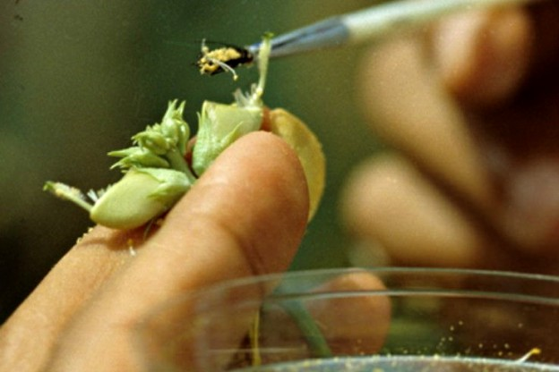
교배
http://indianapublicmedia.org/focusonflowers/hybrids/

Slide 5
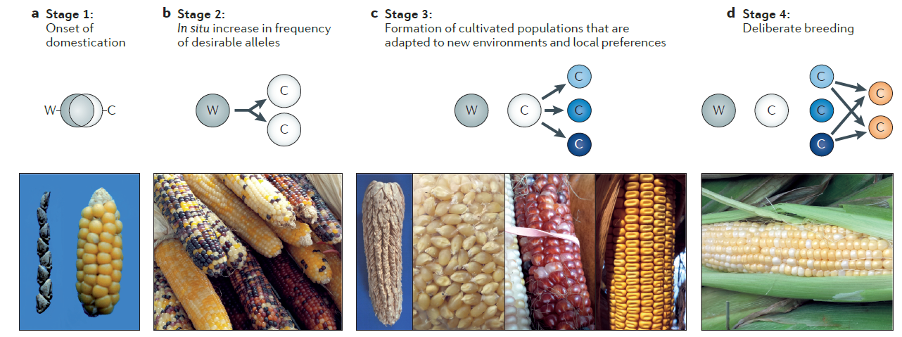
https://www.nature.com/articles/nrg3605

Slide 6
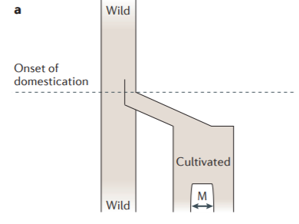
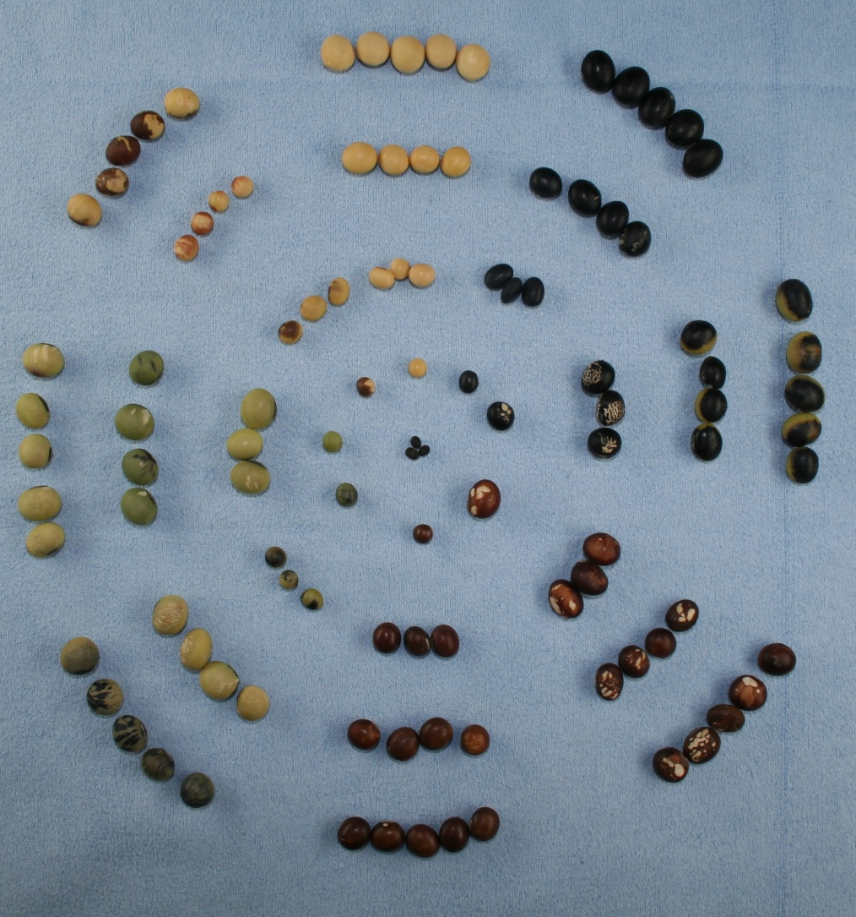
Diversity
Locus 1
Locus 2
Locus 3
:
:
Locus j-2
Locus j-1
Locus j
Phenotypic diversity from nature
Allele diversity from nature

Slide 7
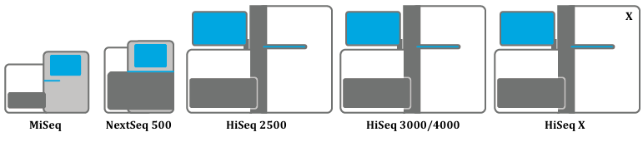
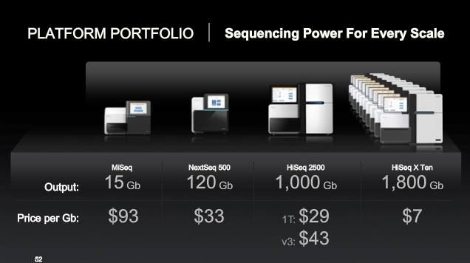

1G당 1만원

Slide 8
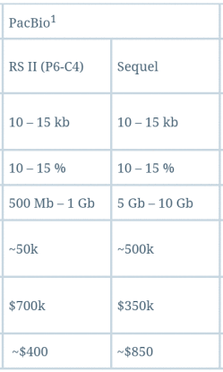
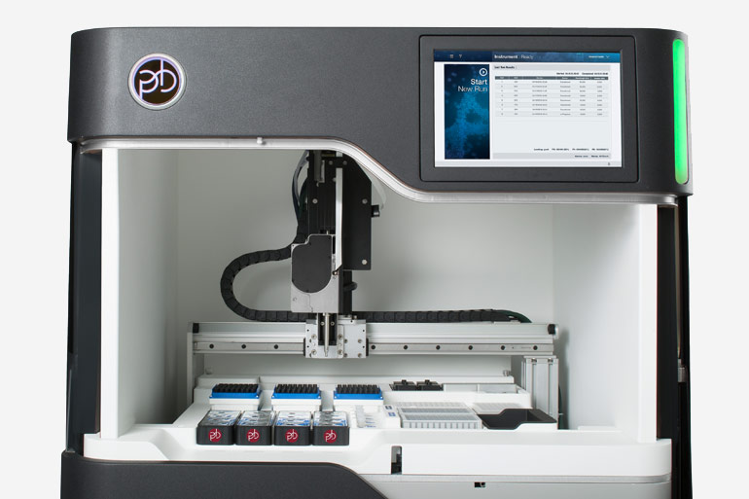

1G당 20만원

Slide 9
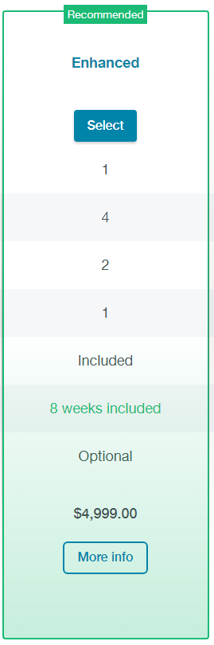
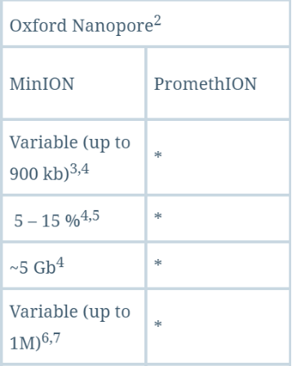
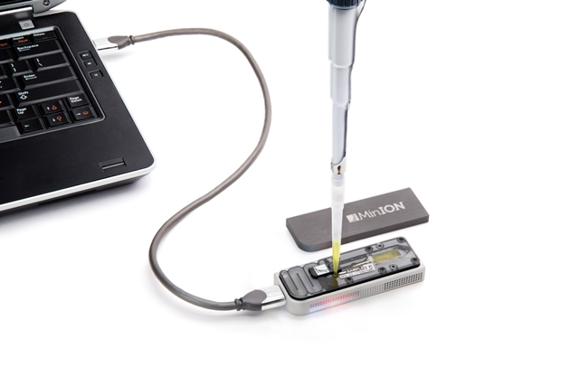

1G당 25만원

Slide 10
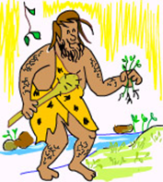
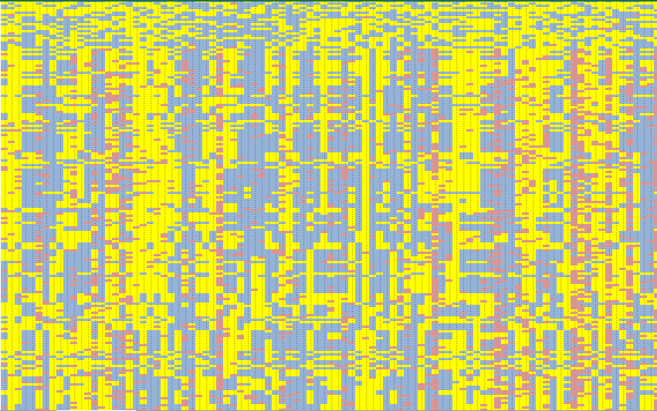
Allele combination of individuals
Locus 1
Locus 2
Locus 3
:
:
Locus j-2
Locus j-1
Locus j
Phenotypic diversity from nature
Allele “combination” from nature

Slide 11

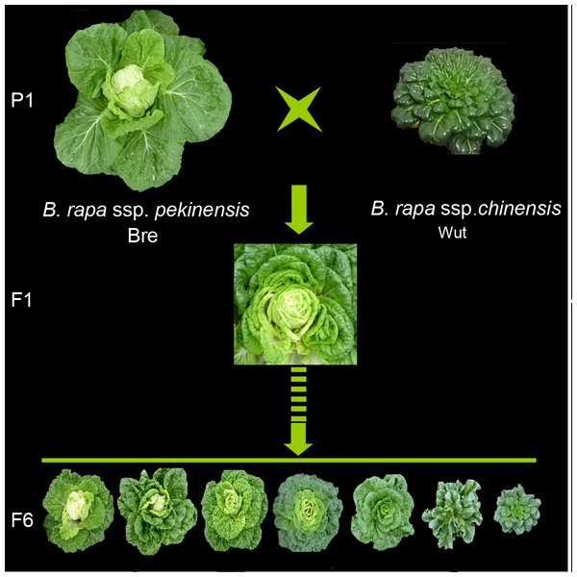
Allele combination of individuals
Locus 1
Locus 2
Locus 3
:
:
Locus j-2
Locus j-1
Locus j
http://journals.plos.org/plosone/article?id=10.1371/journal.pone.0076059
Allele “combination” from breeding

Slide 12
Allele combination of individuals
Locus 1
Locus 2
Locus 3
:
:
Locus j-2
Locus j-1
Locus j
표현형
Genome-wide association analysis
QTL
analysis
후보 유전자, 쓸만한 마커

Slide 13
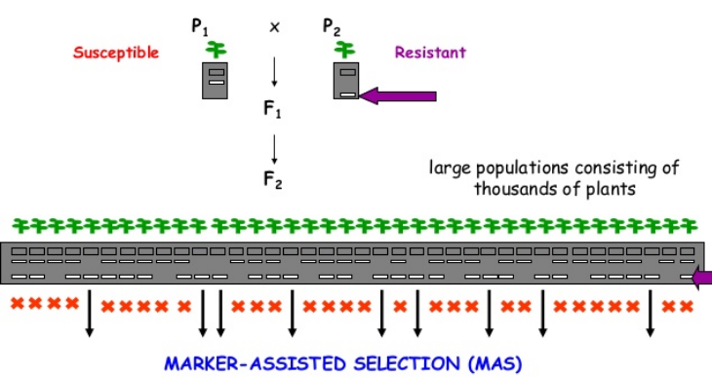
https://www.slideshare.net/FAOoftheUN/marker-assisted-selection-55689355

Slide 14
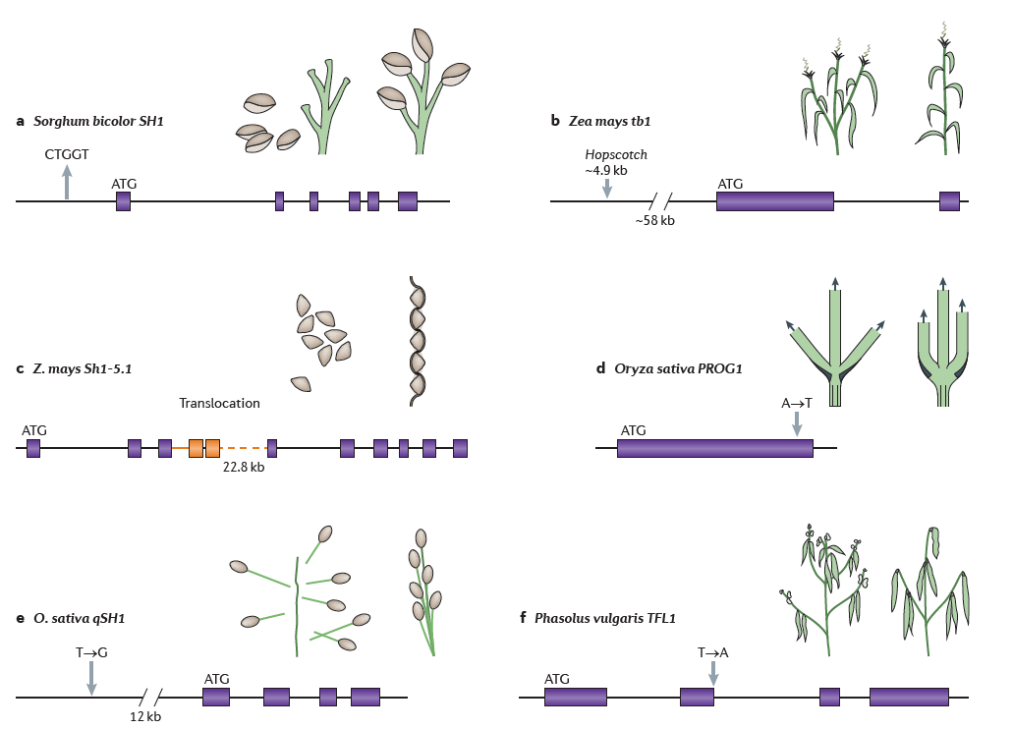
https://www.nature.com/articles/nrg3605

Slide 15
GWAS 경우의 수
Few loci
Many loci
Rare variants
Common variants
Large effect size
Small effect size
Trait

Slide 16
성공적 GWAS
Few loci
Many loci
Rare variants
Common variants
large effect size
Small effect size
Trait

Slide 17
어려운 GWAS
Few loci
Many loci
Rare variants
Common variants
large effect size
Small effect size
Trait

Slide 18
어려운 GWAS
Few loci
Many loci
Rare variants
Common variants
large effect size
Small effect size
Trait

Slide 19
Gene A
Gene B
Gene C
Gene D
Ind 1
Ind 2
Ind 3
Ind 4
Ind 5
Ind 6
Ind 7
A
A
A
A
A
A
T
T
A
A
A
A
A
A
G
C
C
C
C
C
C
G
G
G
C
G
G
G
ATGG : 1
AACG : 2
AACG : 2
AACC : 3
AACG : 2
AACG : 2
TACG : 4
A
B
C
D
Informative allele!

Slide 20
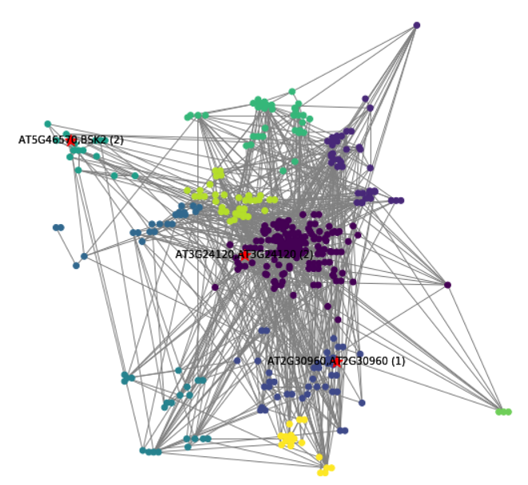
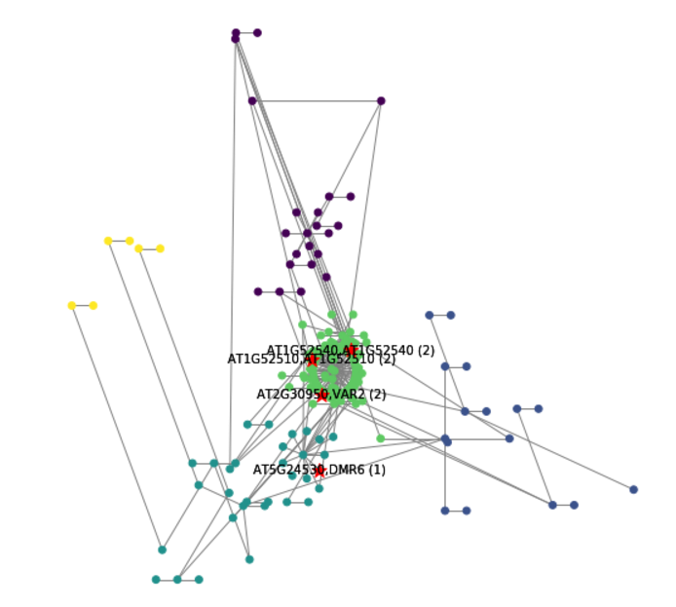
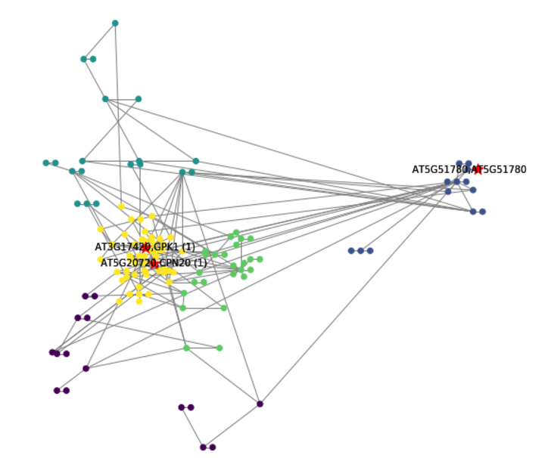
Combination of interactome and genome
Drought tolerance GWAS in A.thaliana
Chr1
Chr2
Chr3
Chr4
Chr5
Community 1
Community 2
Community 17

Slide 21
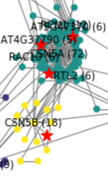
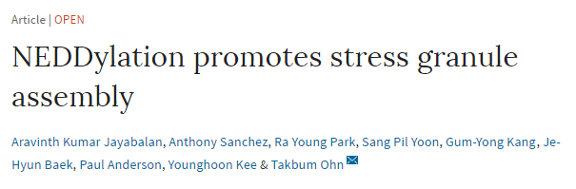
CSN5A
“Encodes a subunit of the COP9 complex that is involved in protein deneddylation.”
CSN5B
GWAS 의 sensitivity 를 증가시킬 수 있는 방법으로 Interactome이 쓸만하다.
현재 Network 기반으로 genotype encoding하는 방법을 개발중입니다.

Slide 22
Locus discovery
Phenotype prediction
Allele combination of individuals
Allele combination of individuals
Locus 1
Locus 2
Locus 3
:
:
Locus j-2
Locus j-1
Locus j
Locus 1
Locus 2
Locus 3
:
:
Locus j-2
Locus j-1
Locus j
표현형
표현형
Genome-wide association analysis
QTL
analysis
Model training
Phenotype prediction
후보 유전자, 쓸만한 마커
Genomic selection : 유전체기반 선발

Slide 23
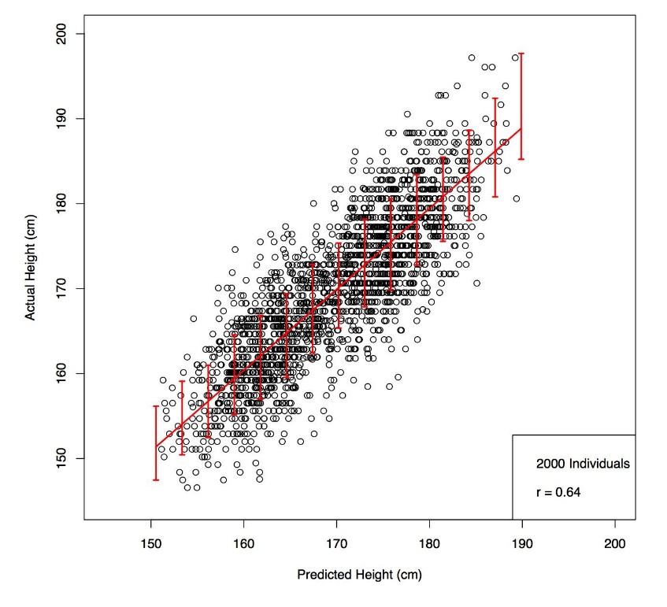
인간 유전체
유전형과 키의 상관관계
- 5만개의 SNP
- 45만명의 데이터
https://www.biorxiv.org/content/early/2017/09/18/190124

Slide 24
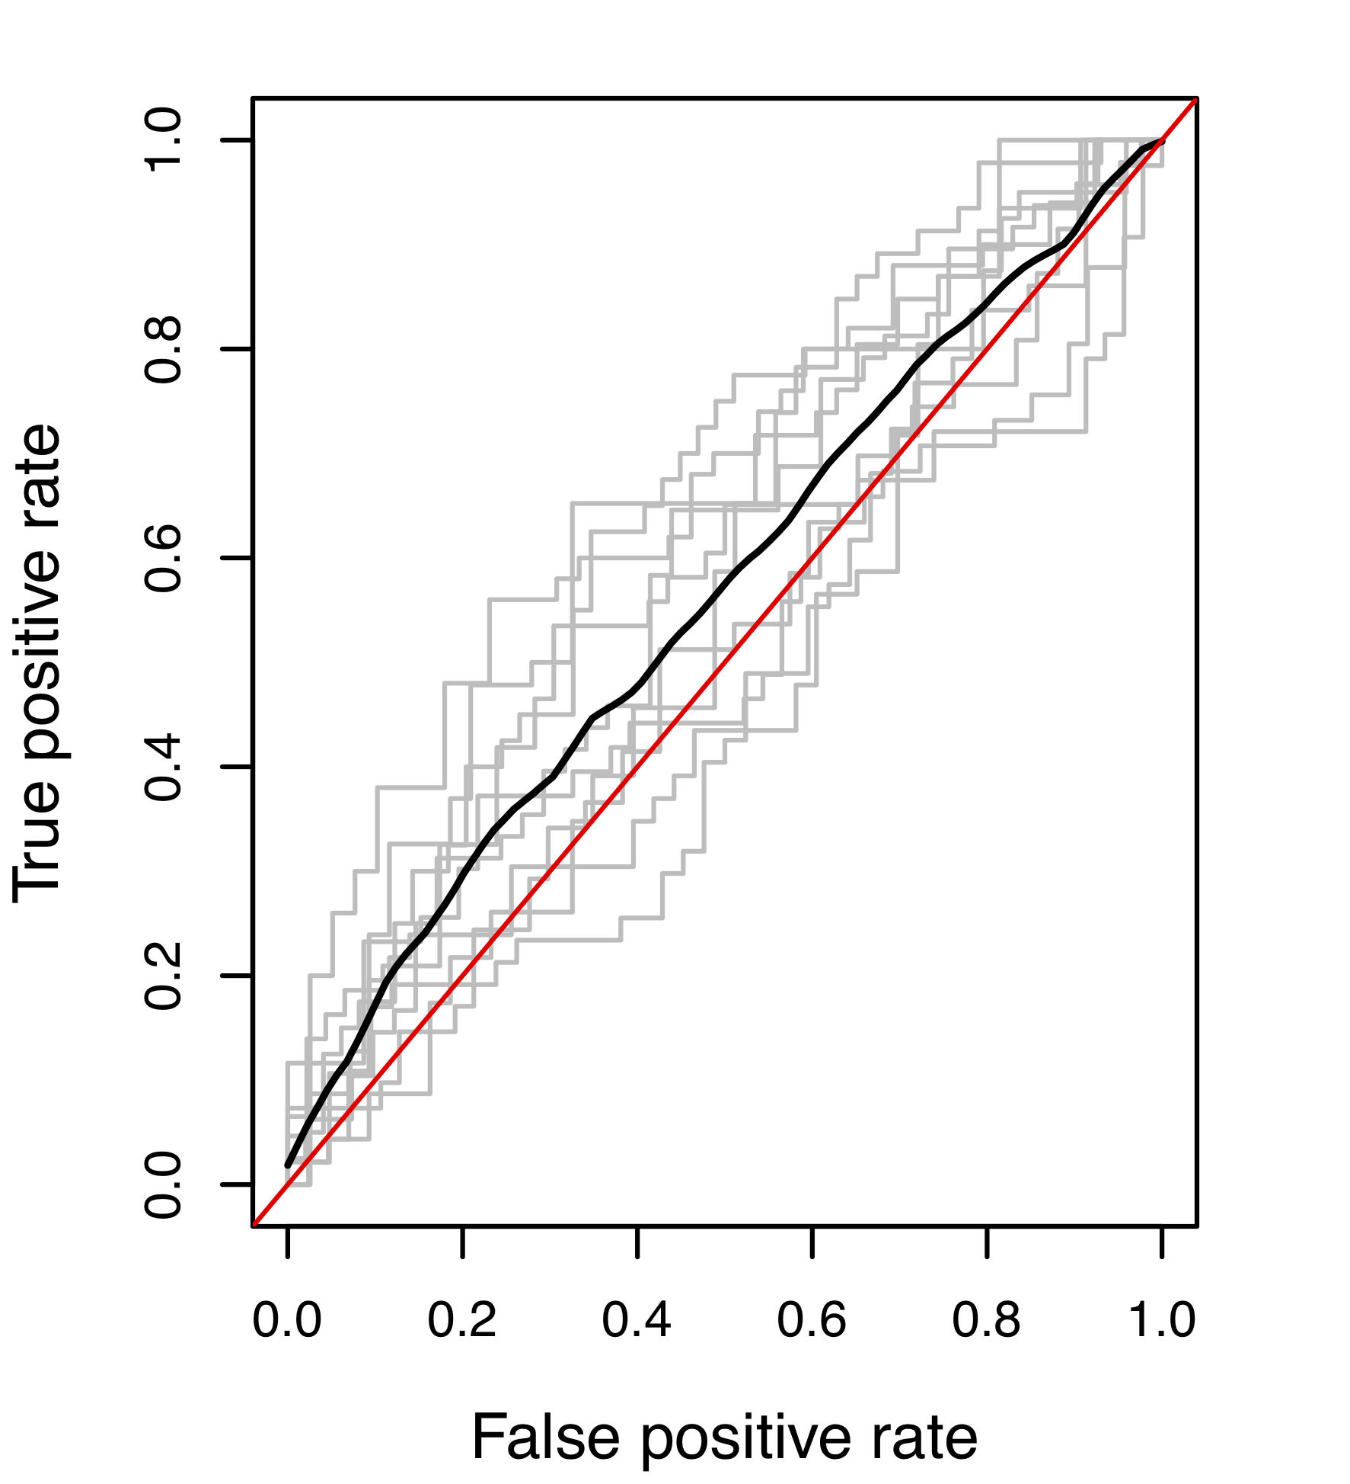
소 유전체
Trait : Johne’s disease
Samples : 450 cases and 439 controls (Cattle)
Data : 7k SNPs
http://journals.plos.org/plosone/article?id=10.1371/journal.pone.0088380

Slide 25
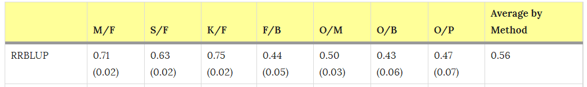
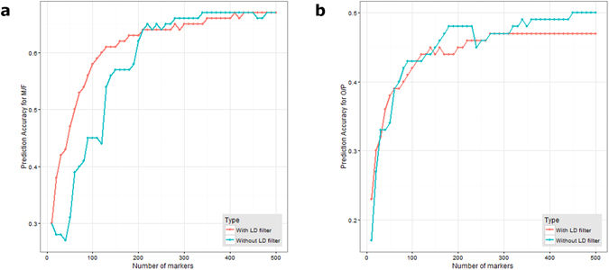
Oil palm 유전체
과피/과육
과실수/다발

Slide 26
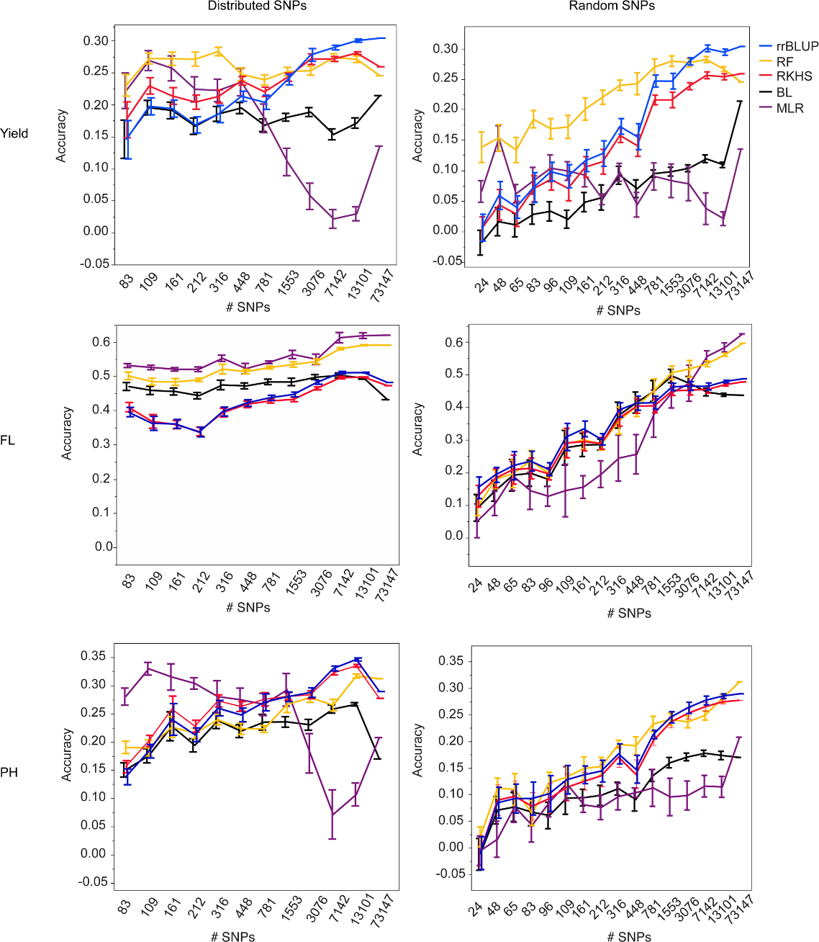
벼유전체
http://journals.plos.org/plosgenetics/article?id=10.1371/journal.pgen.1004982

Slide 27
Accuracy 를 올리기 위해서는?

Slide 28
Few loci
Many loci
ATGG : 1
AACG : 2
AACG : 2
AACC : 3
AACG : 2
AACG : 2
TACG : 4
Rare variants
Common variants
A
B
C
D
large effect size
Small effect size
Informative allele!
Trait
+ 핵심집단 작성
+ 정밀육종집단 작성 (예 : Nested Association Mapping population)
+- Rare variants의 지분을 늘릴 수 있다.
+ 초정밀 genotyping chip
+ Resequencing 기반 matrix 작성
+- Rare variants를 최대한 살리고, multi locus informative allele을 구축할 수 있다.
+ 신뢰도 높은 표현형 조사
+ 4차산업메서드를 써보자

Slide 29
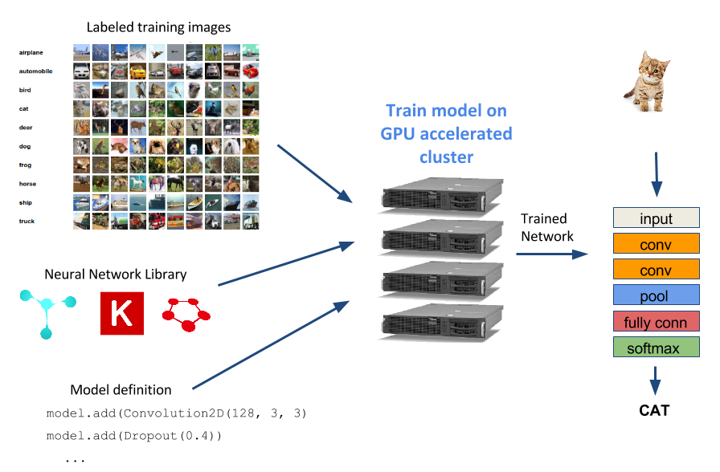
Preliminary research using DNN for genomic selection
https://blog.rescale.com/deep-neural-network-hyper-parameter-optimization/

Slide 30
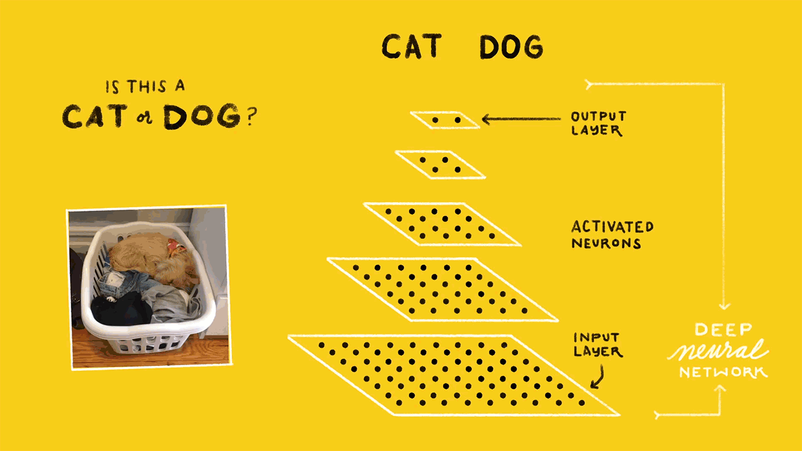

Slide 31
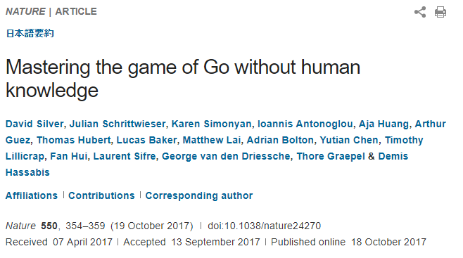
“…Starting tabula rasa (맨땅에서 시작해서), our new program AlphaGo Zero achieved superhuman performance, winning 100–0 against the previously published, champion-defeating AlphaGo…”

Slide 32
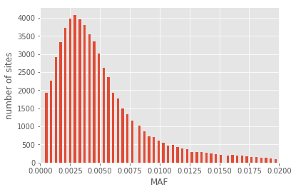
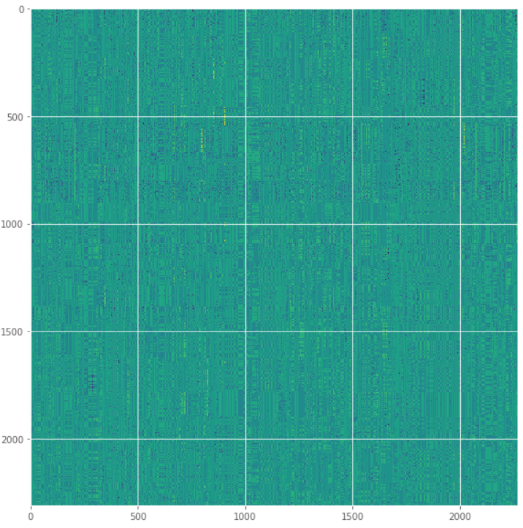
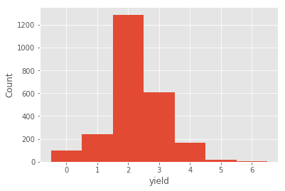
Genomic selection using DNN
Data : soybean NAM derived from 8 parents
2436 individuals
65324 segregating SNPs
2268 SNPs (MAF>0.02)
2311 individuals

Slide 33
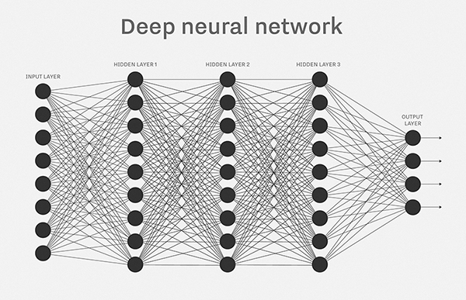
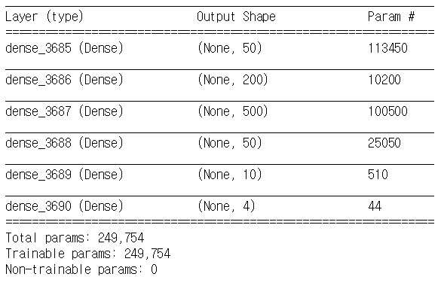
Basic fully connected network

Slide 34
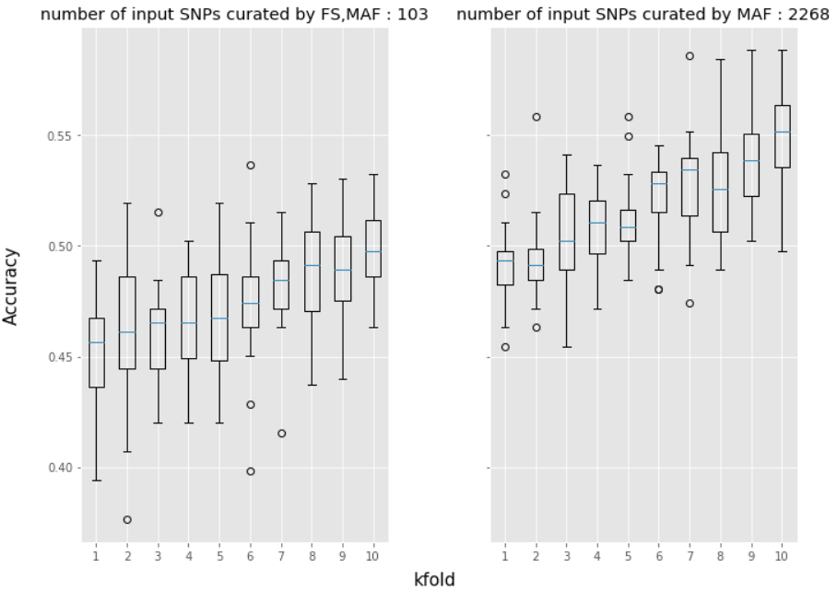
Feature selection from parents classification
MAF > 0.02
103 SNPs
MAF > 0.02
2268 SNPs

Slide 35
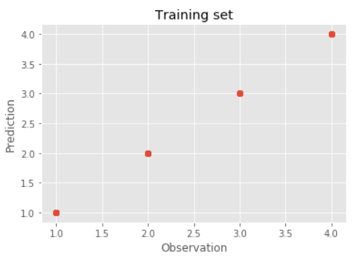
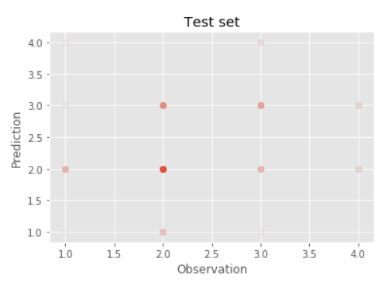

Slide 36
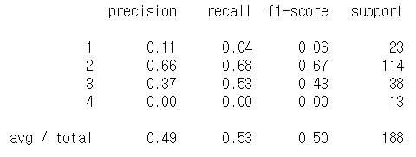
Accuracy 를 올리기 위해서는?

Slide 37
표현형 기반 유전형 확보

Slide 38
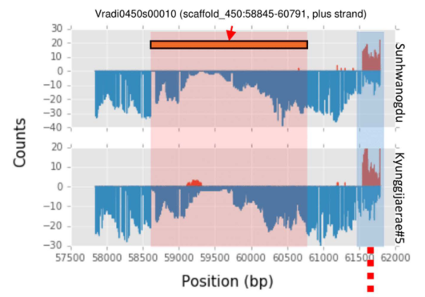
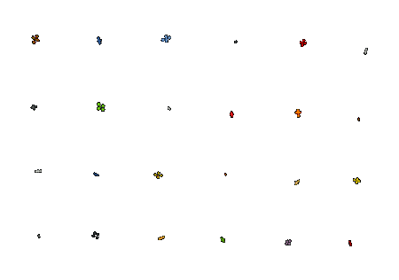
Additional Omics data for hidden features
FPKM : 9.27
Genome
Epigenome
Transcriptome
Translatome
FPKM : 130.19
Phenome, metabolome
Non-coding?
SNP
DNA methylation
How ?
Gene expression
phenotype
Kang, Y.J., et al., Genome-wide DNA methylation profile in mungbean. Sci Rep, 2017. 7: p. 40503.

Slide 39
Summary
+ Genome big (?) data era
+ On the way from “locus discovery” to “phenotype prediction”
+ Genomic selection using DNN works fine
+ For optimizing training data,
+ Well-curated training set is necessary
+- Design population including landrace, breeding population
for training - even number of samples for each class
+ Multi Omics approaches providing additional features
+- Interactome
+- Epigenome
+- Transcriptome
+- Translatome
+ HT phenotyping platforms
+- Metabolome, Phenome

Slide 40
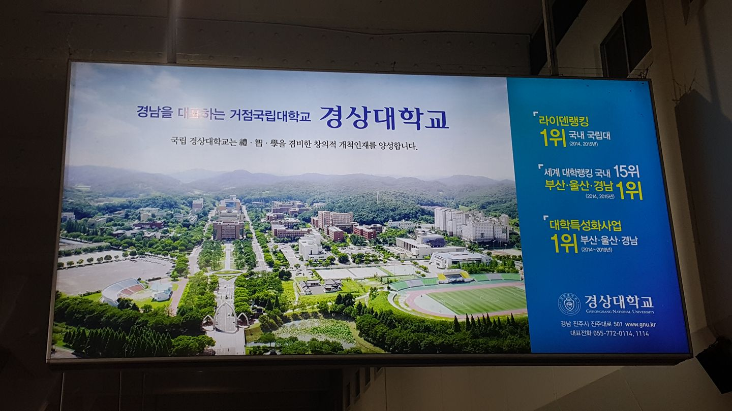
경청해주셔서 감사합니다.

